Slide 1
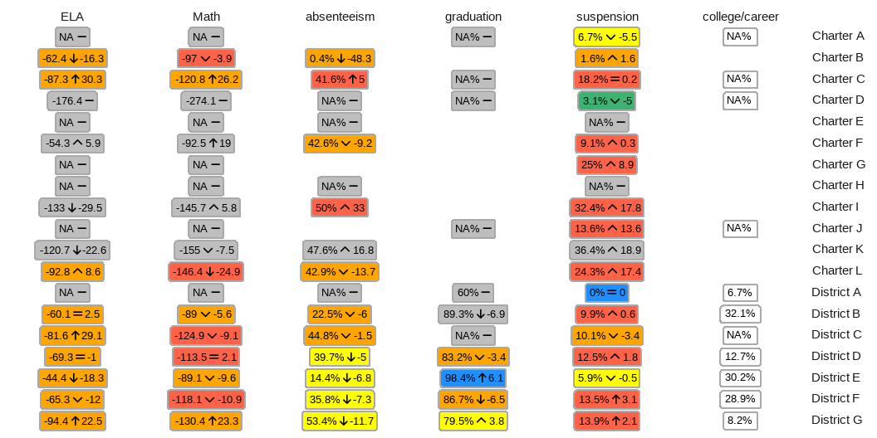
2023 Black/African American Student Outcomes

Slide 2
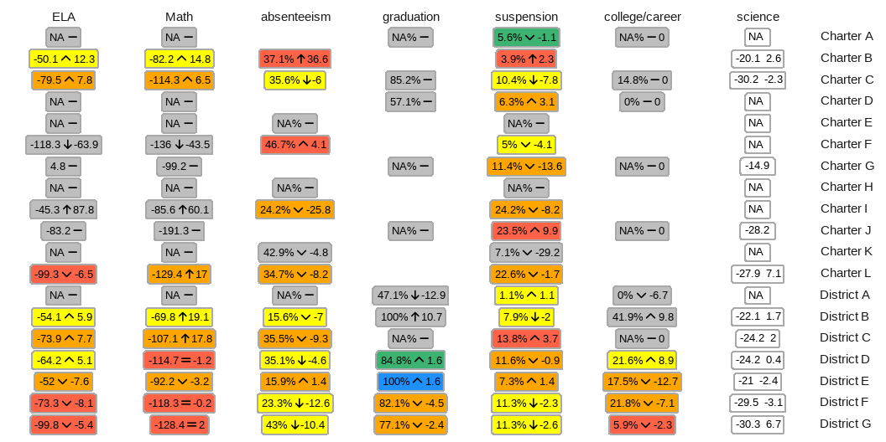
2024 Black/African American Student Outcomes

